Slide 1
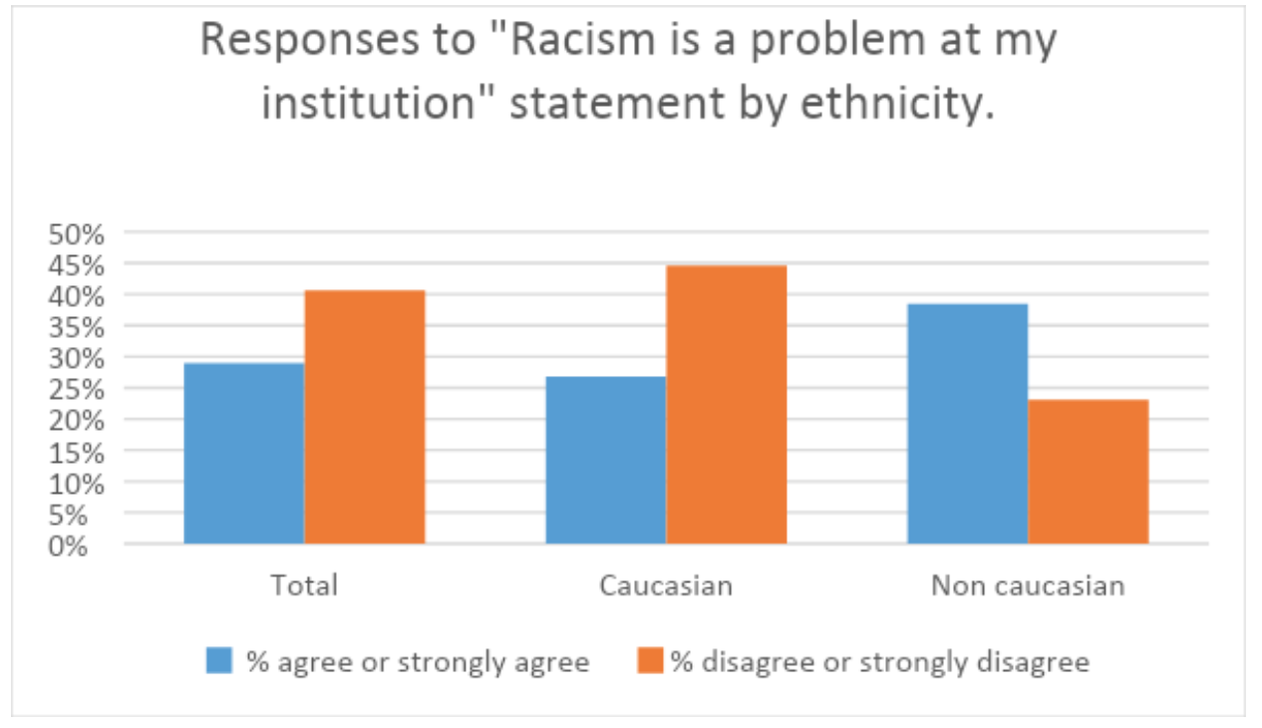
Question: Describe three findings from the data (3 marks)
Do Now
Reminders:
Phones away
Bags on floor
Books out
Pens out
Whiteboard

Slide 2
Categories the following data collection tools:
Do Now
 | Interviews | Likert scale | Heart rate
Subjective OR Objective
Qualitative OR Quantitative
Reminders:
Phones away
Bags on floor
Books out
Pens out
Whiteboard

Slide 3
Write 2 likert scale questions that could help measure a persons extroversion
Do Now
Reminders:
Phones away
Bags on floor
Books out
Pens out
Whiteboard

Slide 4
Chloe is a personal trainer at Gold’s Gym. Although she has always officially led a “straight edge” lifestyle and denounced the use of anabolic steroids, she’s always secretly wondered if they helped people get significantly stronger. She decides to find out. She purchases some steroids off the black marker from her dealer Jiggy and convinces half of her clientele at the gym to start injecting. This continues for thirty days while Chloe keeps a journal of how much weight each person in the two groups can squat. At the end of the month she compares the results.
Do Now
Identify the:
1. IV and DV
2. Experimental group and Control group
Write an operationalized hypothesis for this scenario
Reminders:
Phones away
Bags on floor
Books out
Pens out
Whiteboard

Slide 5
Chloe is a personal trainer at Gold’s Gym. Although she has always officially led a “straight edge” lifestyle and denounced the use of anabolic steroids, she’s always secretly wondered if they helped people get significantly stronger. She decides to find out. She purchases some steroids off the black marker from her dealer Jiggy and convinces half of her clientele at the gym to start injecting. This continues for thirty days while Chloe keeps a journal of how much weight each person in the two groups can squat. At the end of the month she compares the results.
Do Now
Identify the:
1. IV and DV
2. Experimental group and Control group
Write an operationalized hypothesis for this scenario
Reminders:
Phones away
Bags on floor
Books out
Pens out
Whiteboard

Slide 6
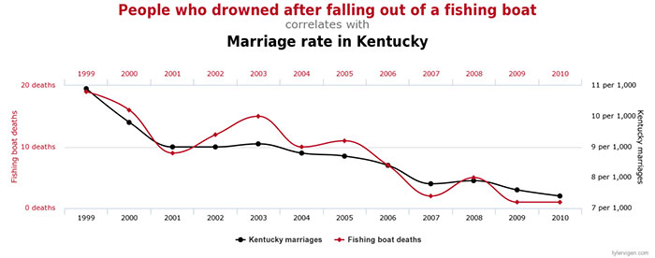
1. How many fishing boat deaths were there in 2004? 2. Describe the correlation between the years 1999 to 2001.
Do Now
Reminders:
Phones away
Bags on floor
Books out
Pens out
Whiteboard

Slide 7
Group behaviour task
Reminders
Assessment due: Tuesday Week 4 – Investigation

Slide 8

Learning Intention
By the end of the lesson I will be able to:
Collect data for my last investigation
Explain 3 different group dynamics
Success Criteria
Everyone
Participated in the group competitive activity
Completed my reflection survey
Researched and compared 3 different leadership styles

Slide 9
TITLE
LO: Explain the process of neural transmission (3.3)
Vocabulary
Define:
TEXT
-text
-text
Concept Development
Checking for understanding
Summarise Define Explain

Slide 10
TITLE
LO: Explain the process of neural transmission (3.3)
Vocabulary
Define:
TEXT
-text
-text
Concept Development
Checking for understanding
Summarise Define Explain

Slide 11
TITLE
LO: Explain the process of neural transmission (3.3)
Vocabulary
Define:
TEXT
-text
-text
Concept Development
Checking for understanding
Summarise Define Explain

Slide 12
The process of neural transmission
Past exam questions and answers:
LO: Explain the process of neural transmission (3.3)
Q: Explain the process of neural transmission and the role the synapse plays. (5 marks)
A:Synapse is the small space between the sending neuron and the receiving neuron and where synaptic transmission occurs (1). Electrical impulse travels down the axon of the pre-synaptic neuron (i.e. a stimulus causes an action potential which generates another action potential just in front of it) (1) and pushes vesicles containing neurotransmitters to the axon terminal (1). Neurotransmitters/Chemical messengers (1) are sent across the synapse to receptor sites on the dendrite of the post-synaptic neuron (1).
Skill Development/Guided Practice
Checking for understanding
Identify what marks were allocated for in the above questions.

Slide 13
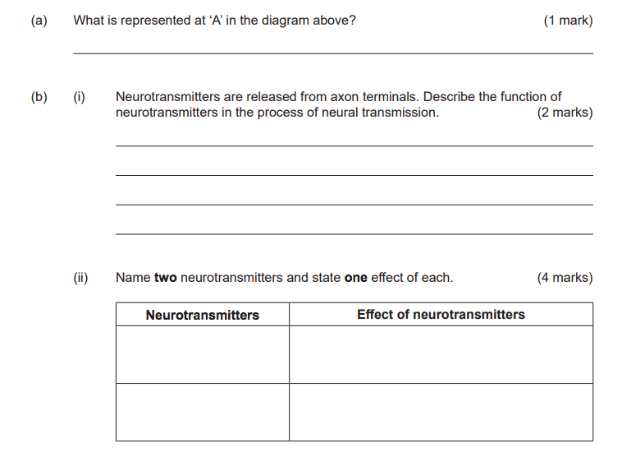
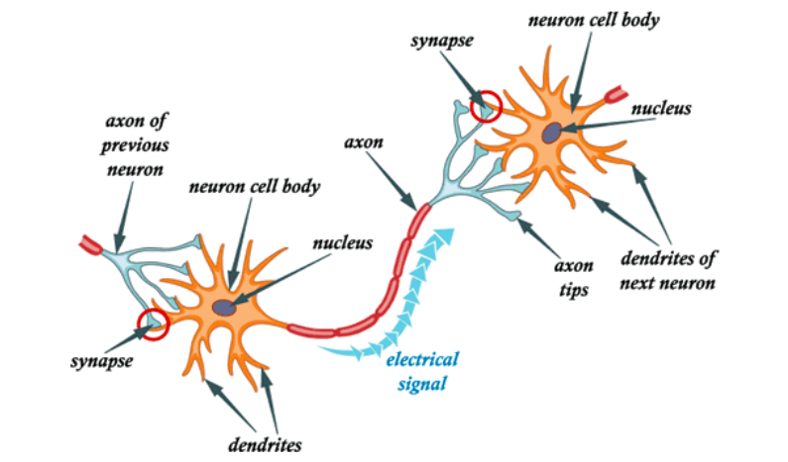
Why is it relevant to be able to explain the process of neural transmission?
So we can understand how messages are transmitted to and from the brain.
To do well in the 12 ATAR Psychology course:
LO: Explain the process of neural transmission (3.3)
Past exam question:
Curriculum links:
Unit 3 - Self – Biological influences/bases of behaviour Process of neural transmission Role of synapses: action potential (NOT Na/K pump) including resting membrane potential, threshold and direction of the impulse. Role of neurotransmitters: functions Serotonin Dopamine
Relevance
Checking for understanding
Why is it relevant to YOU to be able to explain the process of neural transmission?

Slide 14
Whiteboard reminders.
Write it – start writing your answer
Chin it – Show me your answers
Bin it – Wipe your whiteboard clean
Park it – Lids back on whiteboard markers and whiteboard down
Norms and rules:
1. Do not waste the ink – these pens are for learning and Ms Davey buys the pens (they are expensive).
2. Include everyone – Person who is writing the answer cannot research the answer (use your team, communicate). Swap roles each turn.
3. Be an active learner! – Using the whiteboards get you rehearsing information, making it easier to recall later. It also lets me know what you know and don’t know.

Slide 15
Check your understanding
Collaborative whiteboard or verbal activity
Summarise what you just learnt
5 roles:
Teacher – You will explain what you have just learnt to the rest of your team
Question master - look at the notes and question / extend and fact check the teacher
Scribe – your job to summarise on the whiteboard what the key points are
Reporter – you will be presenting the material to the rest of the class
Motivator – you are time keeper and responsible for keeping everyone on task
Notes:
Teacher questions:
What are the three divisions of the brain?
What is the oldest part of the brain?

Slide 16

Independent practice
Activity..
Questions on SEQTA or
Exam questions timed or
Poster or
Flashcards
Notes:
Teacher questions:
What are the three divisions of the brain?
What is the oldest part of the brain?

Slide 17

Homework
Before X you must have:

Slide 18

Exit Ticket
Fist to five and explain to partner
Ask one get one
SEQTA message
Answer these questions..
Flash whiteboard quiz

